Slide 1
Regression

Slide 2
Why Regression?
Everything we’ve done in this class has been regression:
When you have categorical IVs and continuous DVs, the ANOVA framework is much easier to run/interpret.

Slide 3
Why Regression?
Regression is a type of analysis where you want to be able to predict some scores using other information.
Regression is more flexible than ANOVA because you do not have to have categorical or group variables for your independent variables (but you can).

Slide 4
Definitions
Predictors – these are your independent variables that you want to use to predict the dependent variable.
You can think of them as IVs or Xs.
You can use categorical, Likert, or continuous variables as predictors.

Slide 5
Definitions
Criterion – this variable is your dependent variable or the information you are trying to predict/understand.
You can think of this variable as DV or Y.

Slide 6
b
a
Y-hat = a + bx
Y-hat = β x

Slide 7
Definitions
Essentially, the point of regression is to create an equation that best explains the relationship between Xs and Y.
Equation = Y-hat = a + b₁X₁ + b₂X₂ + …

Slide 8
Definitions
a = Constant, this value is added to the regression equation to help with prediction. Not often reported in research.

Slide 9
Definitions
b (little b) = Coefficient, this value is the unstandardized slope for your regression equation.
Interpretation:
For every one point increase in X, you will get b points increase in Y.
This score will be based on the scale of the variable you are using to predict.

Slide 10
Definitions
β (beta) = Coefficient, this value is the standardized slope for your regression equation.
With one X/predictor beta is equal to Pearson’s r.
Since beta is standardized you can use it to compare across predictors at which IV best explained your DV.
Interpretation:
For every one SD increase in X, you will get β SD increase in Y.

Slide 11
Definitions
Y-hat = The predicted value based on the equation.
If your regression equation is good, it will be close to the actual value for that participant Y (DV).

Slide 12
Definitions
Effect sizes for regression include several types of correlations
Correlations:
r
R
R²
sr
pr

Slide 13
Definitions
r is the correlation between one X and one Y.
R is the correlation or the relationship between your predicted values and people’s actual DV/Y values.
Correlation between Yhat and Y – which means that it is the correlation between multiple Xs and Y.
R² = the amount of variance in the DV scores that your IV/predictors account for. This number is effect size for regression equations.

Slide 14
Definitions
sr = semi-partial correlation, the variance from only that IV over the total variance.
Tells you how much variance overall that variable accounts for.
The unique contribution of that variable to R² – increase in proportion explained Y when that variable is added to the equation.

Slide 15
Definitions
pr = partial correlation, the variance from only that IV over the variance not accounted for (error).
Tells you how much variance your variable accounts for when you only look at variance that you can explain.
Proportion of variance in Y not explain by other predictors.

Slide 16
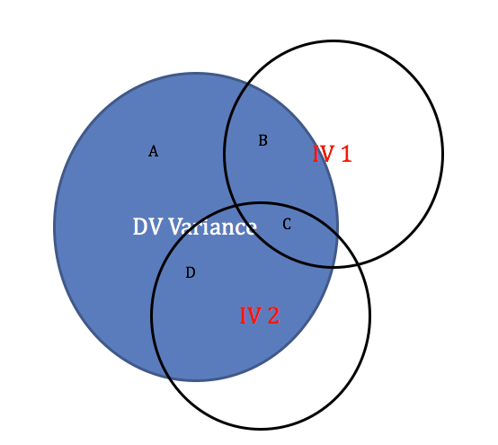
Definitions
R = B + C + D / A + B + C + D
r IV1 = B + C / A + B + C + D
sr IV1 = B / A + B + C + D
pr IV1 = B / A + B

Slide 17
Types
Simple Linear Regression – regression with only one predictor variable (IV).
It’s called simple because there’s only ONE thing predicting.
In this case, beta = r.

Slide 18
Types
Multiple Linear Regression – regression with more than one predictor variable (IVs).
You can use a mix of variables – continuous, categorical, Likert, etc.
You can use MLR to figure out which IVs are the most important.

Slide 19
Types Of MLR
Standard/Simultaneous Linear Regression – all variables are entered into the equation at the same time.
Each variable assessed as if it were the last variable entered
This “controls” for the other IVs, as we talked about the interpretation of b.
Evaluates sr > 0?
If you have two highly correlated IVs the one with the biggest sr gets all the variance.
Therefore the other IV will get very little variance associated with it and look unimportant (suppression).

Slide 20
Types of MLR
Hierarchical / Sequential Linear Regression – predictor variables are entered in as sets or steps. Variance gets assigned at each step to the first variables entered.
IVs enter the regression equation in an order specified by the researcher.
What order?
Assigned by theoretical importance
Or you can control for nuisance variables in the first step
First IV is basically tested against r or sr (since there’s nothing else in the equation it gets all the variance)
Next IVs are tested against pr (they only get the left over variance).

Slide 21
Types of MLR
More about hierarchical regression:
Using SETS of IVs instead of individuals
So, say you have a group of IVs that are super highly correlated but you don’t know how to combine them or want to eliminate them.
Instead you will process each step as a SET and you don’t care about each individual predictor

Slide 22
Types of MLR
Statistical / Stepwise Linear Regression – predictor variables are entered in steps, based on some statistical cutoff.
Entry into the equation is solely based on statistical relationship and nothing to do with theory or your experiment
Types
Forward – biggest IV is added first, then each IV is added as long as it accounts for enough variance
Backward – all are entered in the equation at first, and then each one is removed if it doesn’t account for enough variance
Stepwise – mix between the two (adds them but then may later delete them if they are no longer important).

Slide 23
Interpretation and Purpose of MLR
How good is the equation? Can we predict people’s scores better than chance?
Use the overall model ANOVA statistics, R² for effect size.
Which IVs are the most important? Which contribute the most to prediction?
Use the coefficient statistics (t values) with pr² as the effect size.
This procedures looks suspiciously like ANOVA …

Slide 24
Types of MLR
Special types of MLR also include mediation and moderation.

Slide 25
Mediation
Mediation – analyzing that the relationship between X and Y is changed by the inclusion of another variable M.
c path: Simple regression analysis with X predicting Y
a path: Simple regression analysis with X predicting M
b path: Multiple regression analysis with M predicting Y controlling for X
c’ path: Multiple regression analysis with X and M predicting Y

Slide 26
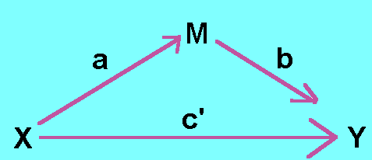
Mediation

Slide 27
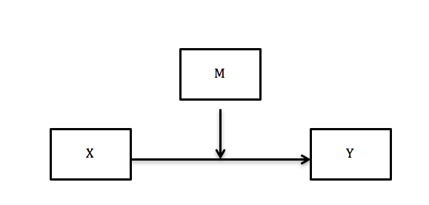
Moderation
Moderation – analyzing an interaction between two X variables in the prediction of Y.
Similar to an interaction effect in ANOVA.

Slide 28
Data Screening
Accuracy and missing data → same.
Outliers → new rules.
Additivity → only look at the IVs correlations.
Normality, linearity, homogeneity, homoscedasticity → same BUT you will run these analyses on your REAL regression, not the fake one.
We don’t need a fake one, we have a real regression set up!

Slide 29
Outliers in Regression
Leverage – how much influence over the slope a person has (how much their score will change b values)
Cut off rule of thumb = (2K+2)/N
K is the number of IV(s) predictors
N is the number of people

Slide 30
Outliers in Regression
Discrepancy – how far away from other data points a point is (no influence on the slope)
Cooks – influence – combination of both leverage and discrepancy
Cut off rule of thumb = 4/(N-K-1)
K is the number of IV/predictors
N is the number of people

Slide 31
Categorical IVs in Regression
When you use categorical IVs in a regression analysis, you must make sure the variable is factored in R.
Otherwise, it will interpret that variable as continuous, which doesn’t make a whole lot of sense.
Whatever variable is coded as the first group in your factored variable becomes the comparison group.
You will automatically get every group compared that one.
What if you want all pairwise? Recode and run again.
We will work an example of these variables to help clarify.
DUMMY CODING

